Slide 1
Progress Report
8/5
HJ. Kwon
Progress Report
NCC-GCSP

Slide 2
Markov Model
HJ. Kwon
Progress Report
NCC-GCSP

Slide 3
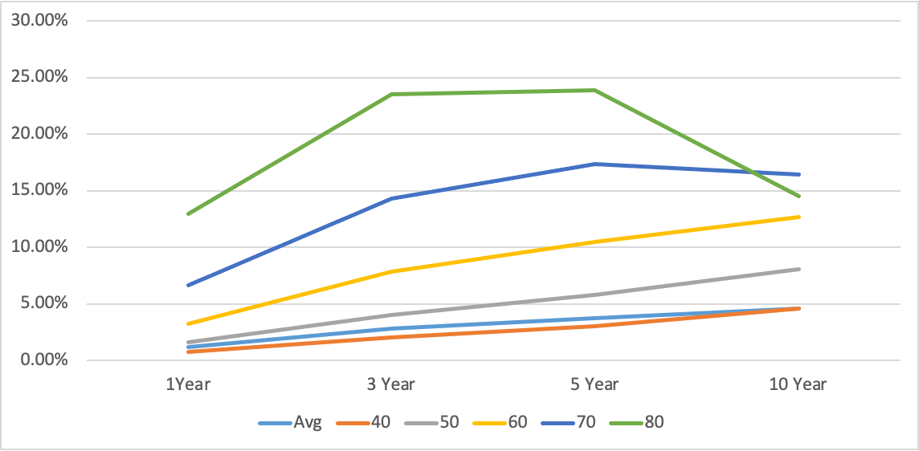
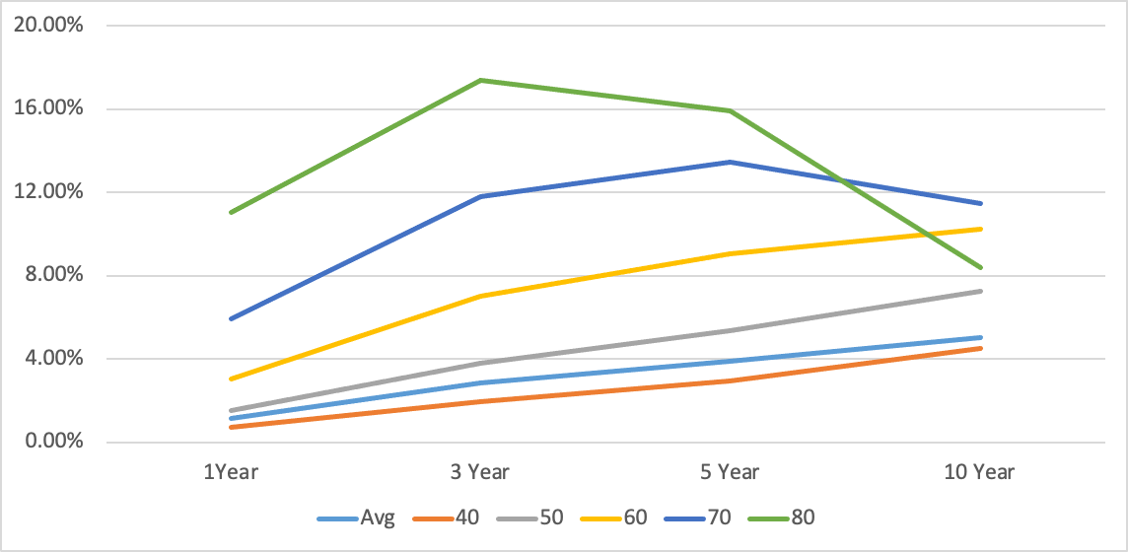
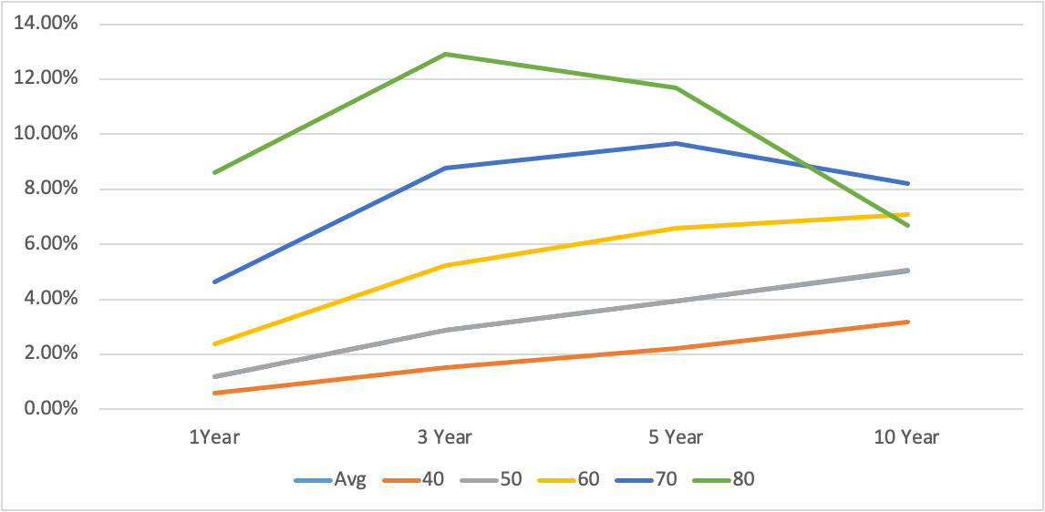
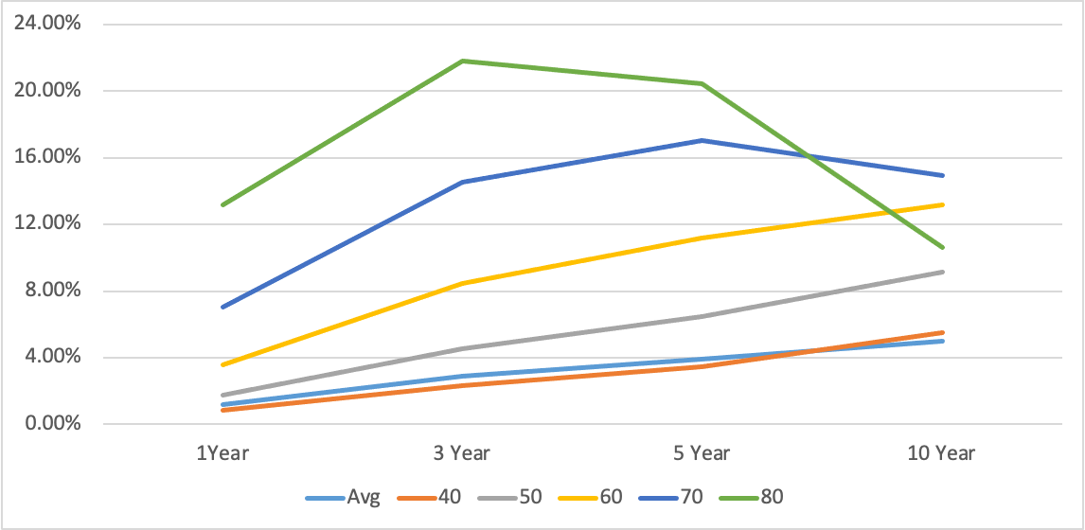
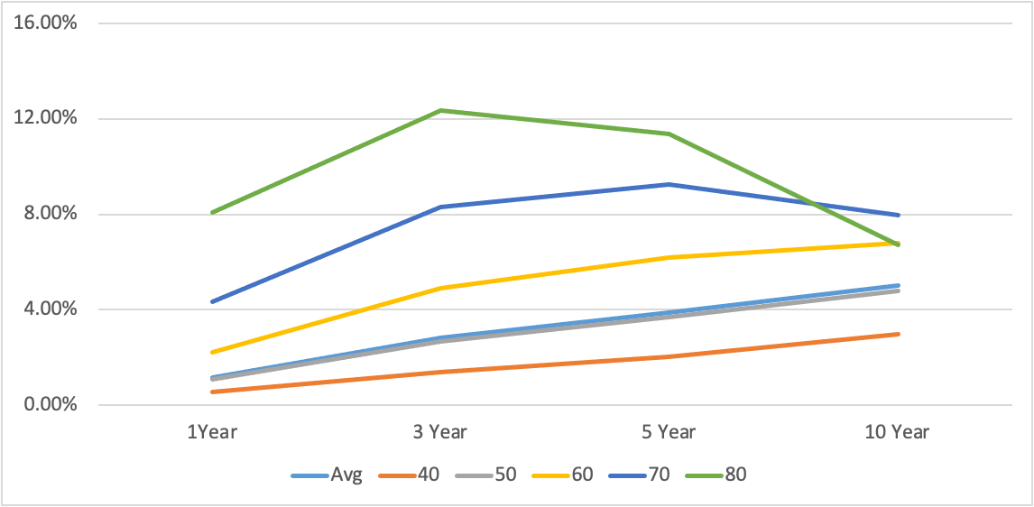
Markov Model - Average model [High to LVC][Male]
HBV
HCV
Age Group
Coinfection
Others
HJ. Kwon
Progress Report
NCC-GCSP

Slide 4
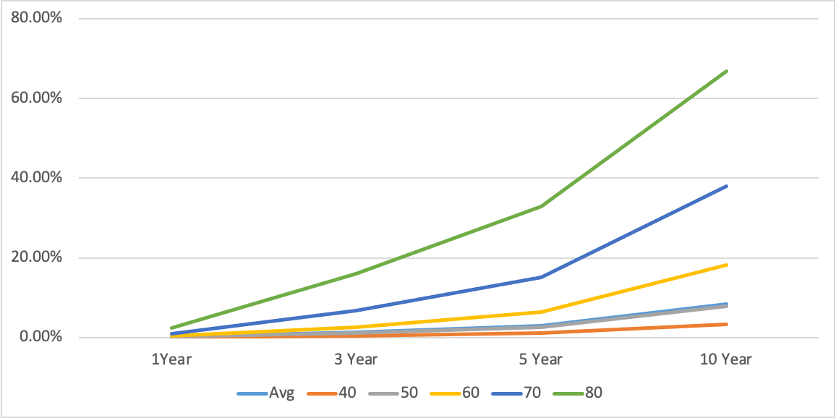
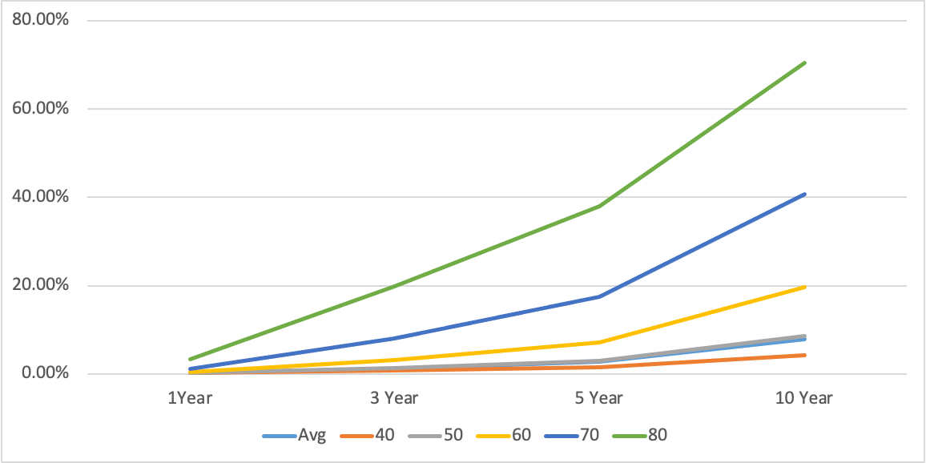
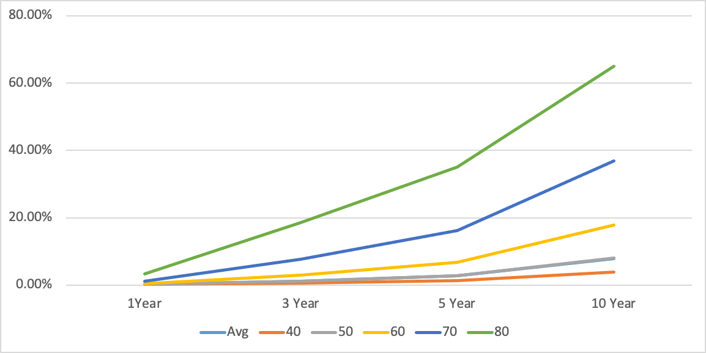
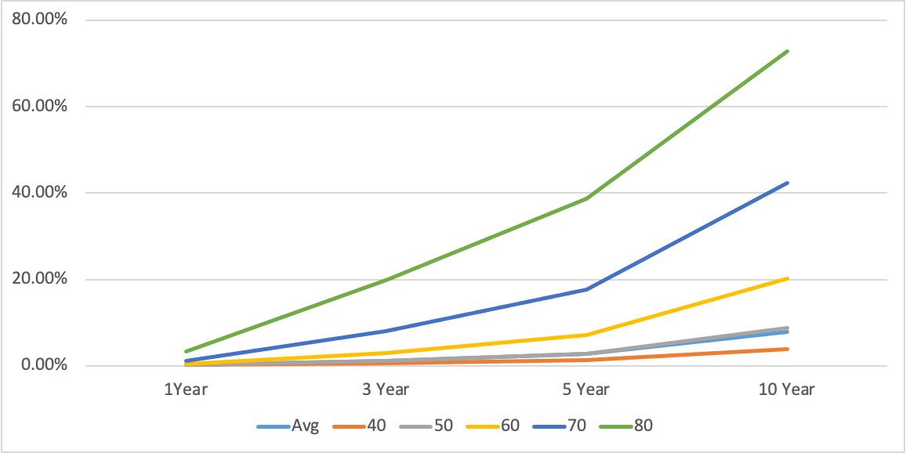
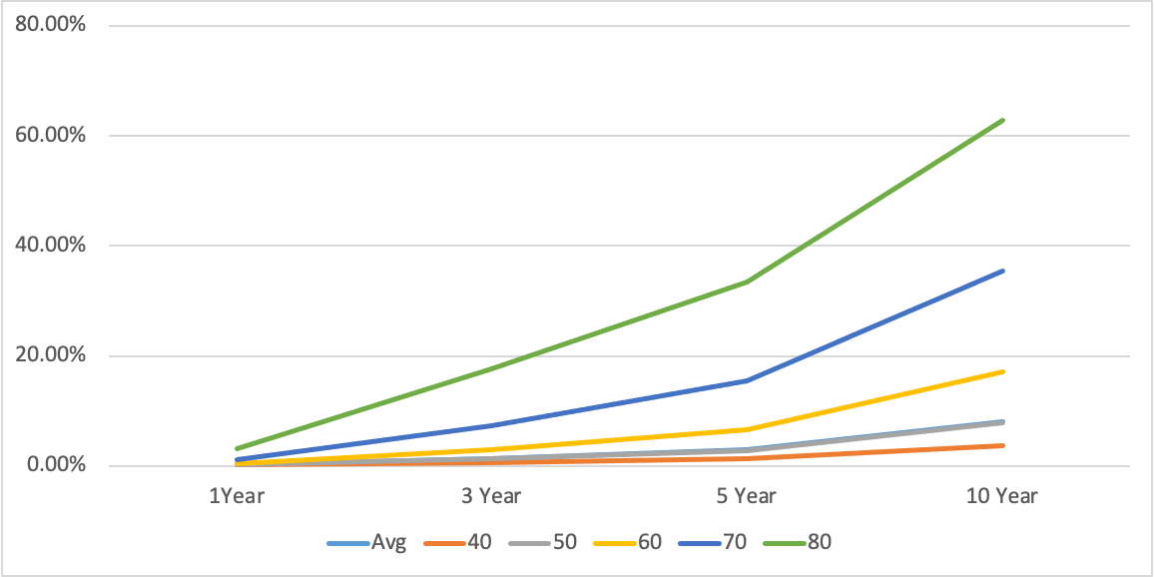
Markov Model - Average model [High to Death][Male]
HBV
HCV
Age Group
Coinfection
Others
HJ. Kwon
Progress Report
NCC-GCSP

Slide 5
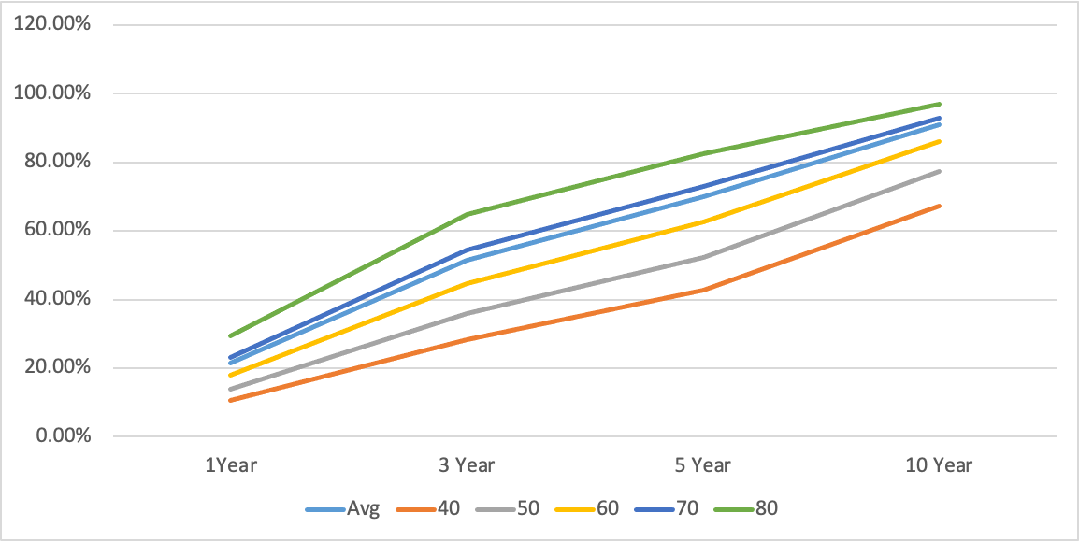
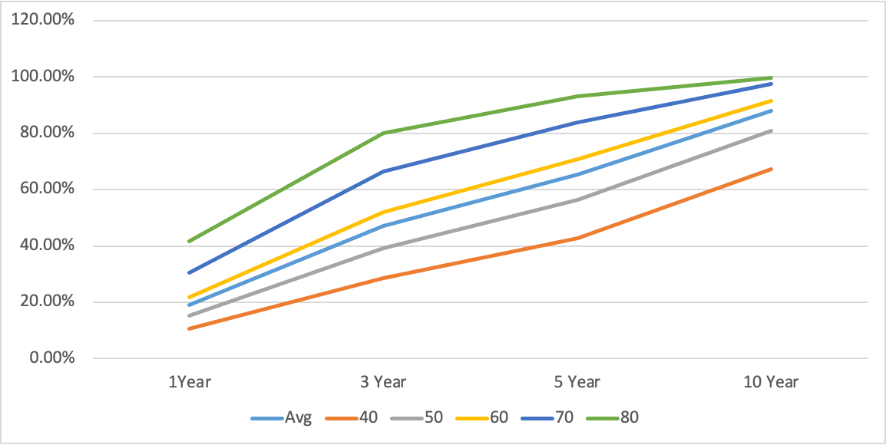
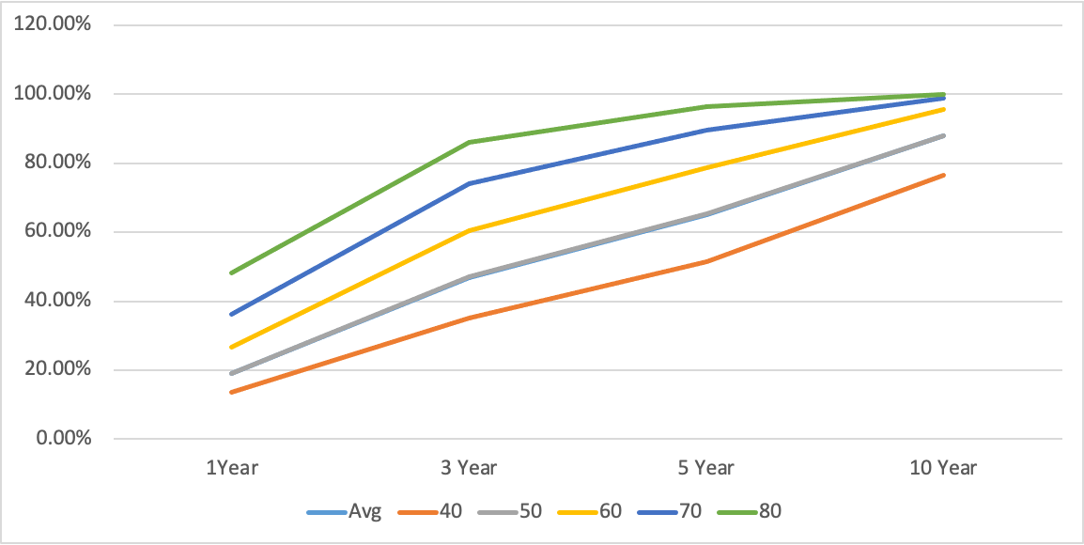
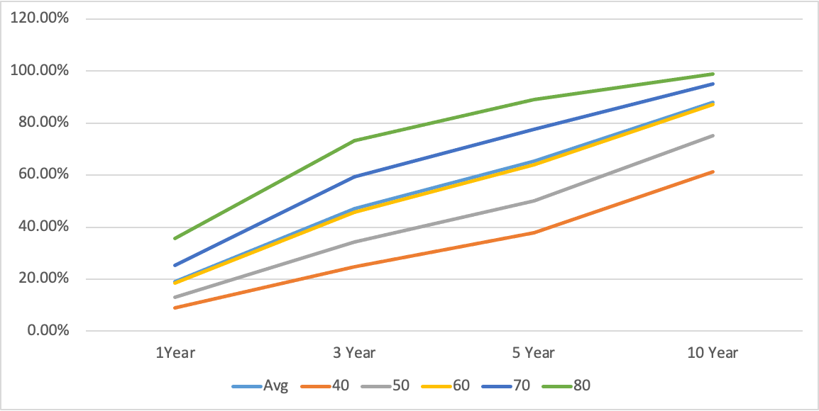
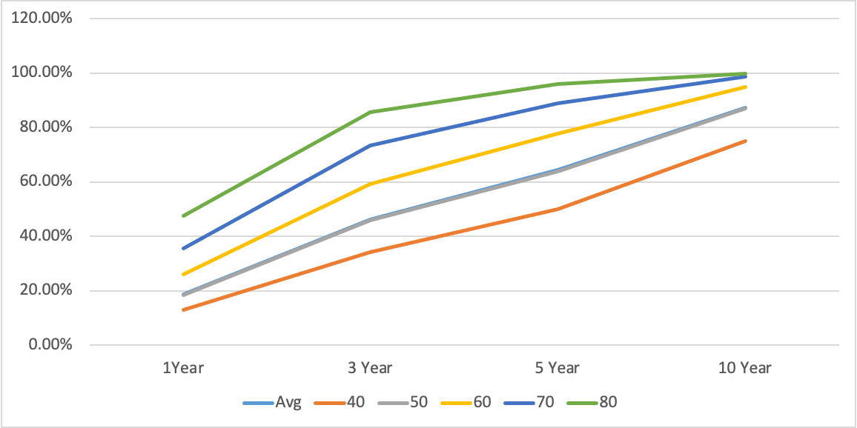
Markov Model - Average model [LVC to Death][Male]
HBV
HCV
Age Group
Coinfection
Others
HJ. Kwon
Progress Report
NCC-GCSP

Slide 6
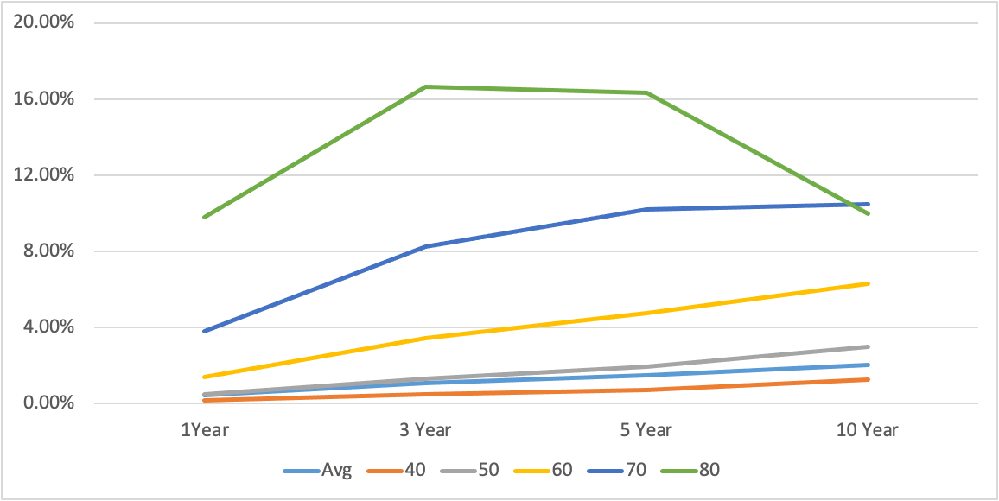
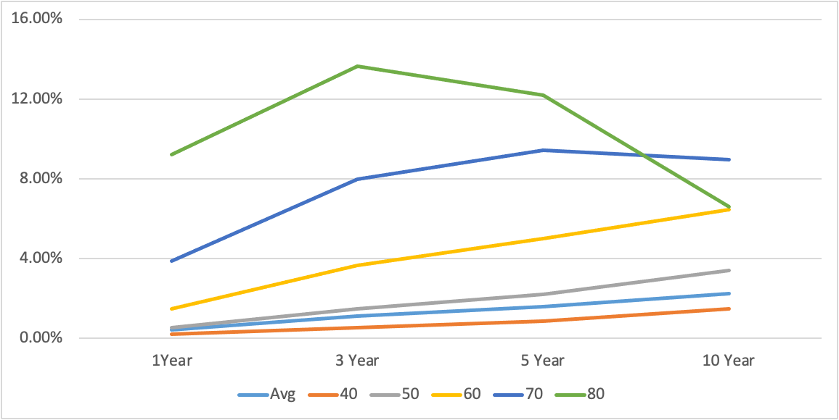
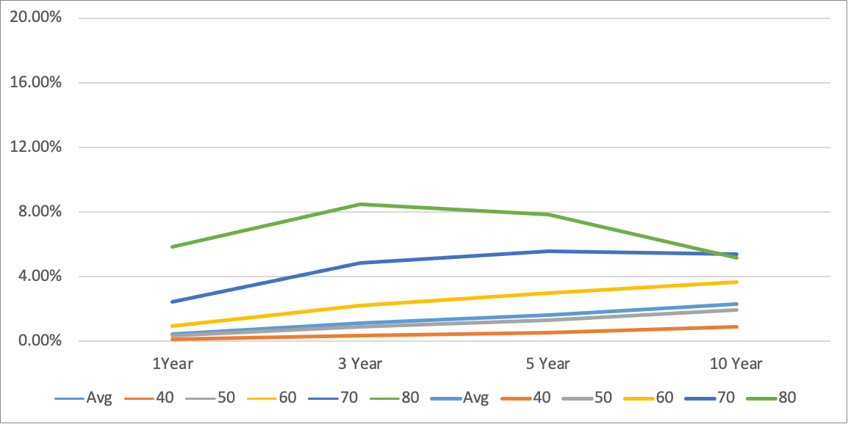
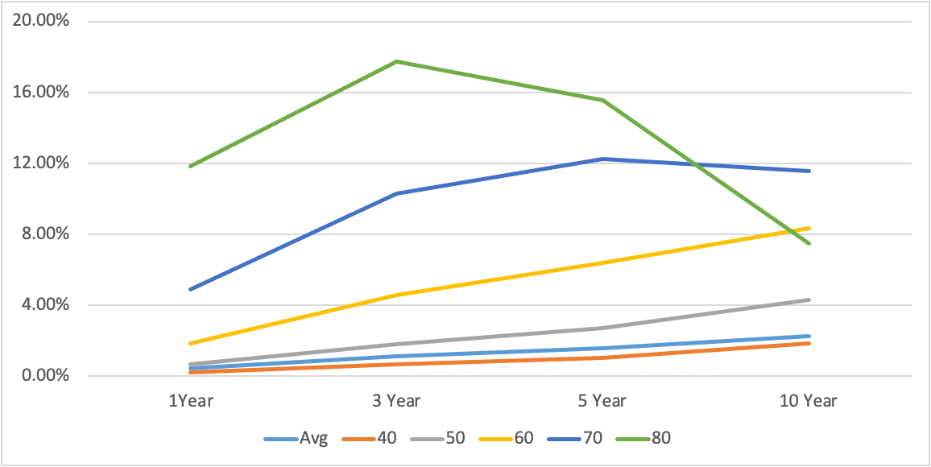
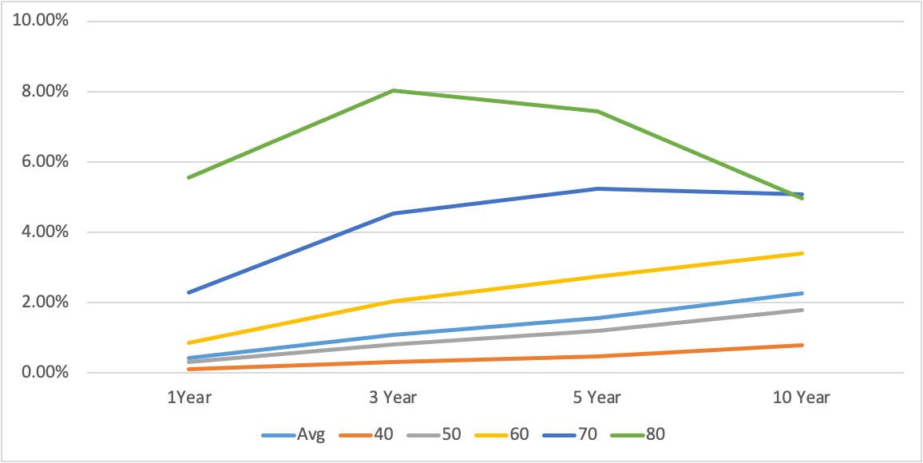
Markov Model - Average model [High to LVC][Female]
HBV
HCV
Age Group
Coinfection
Others
HJ. Kwon
Progress Report
NCC-GCSP

Slide 7
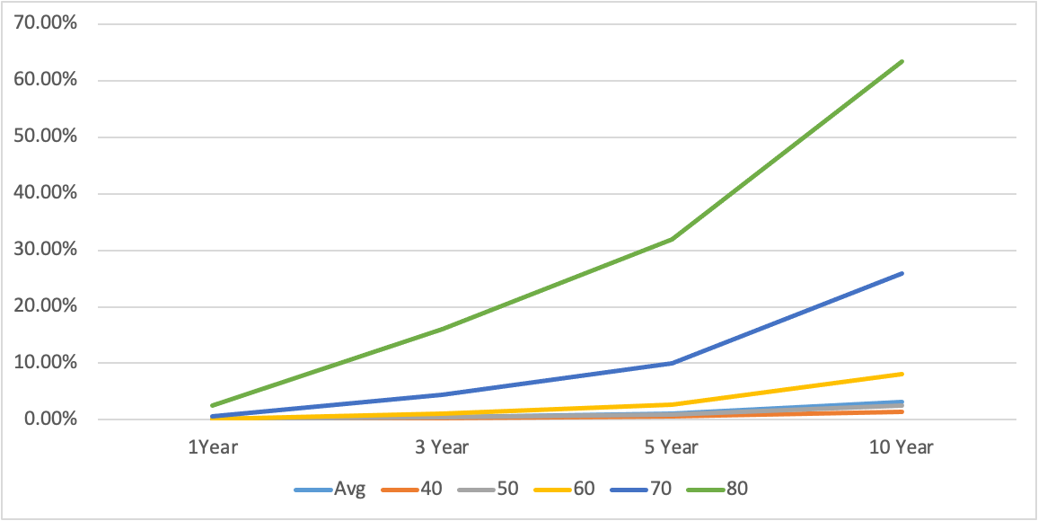
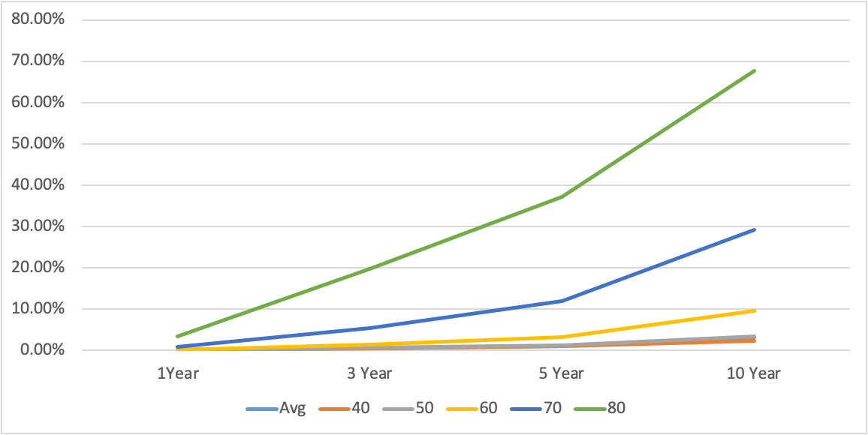
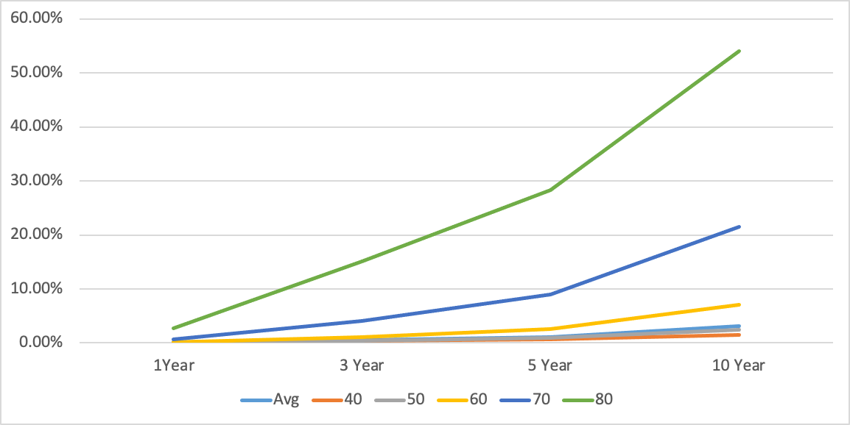
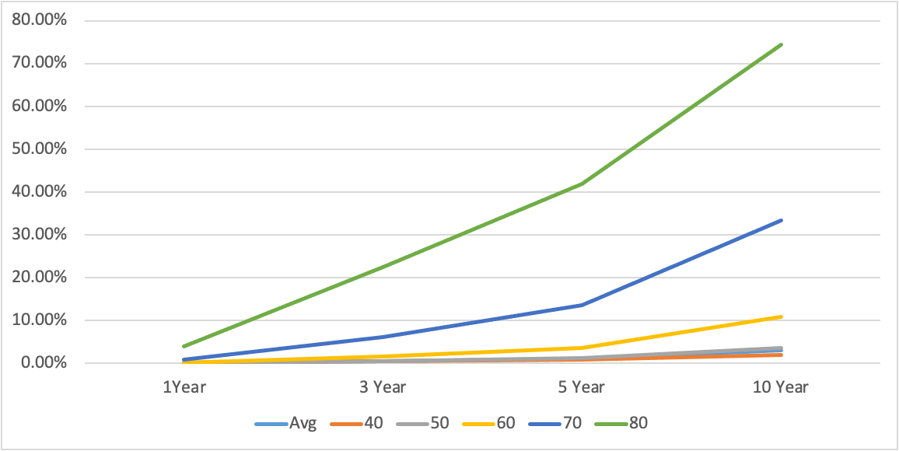
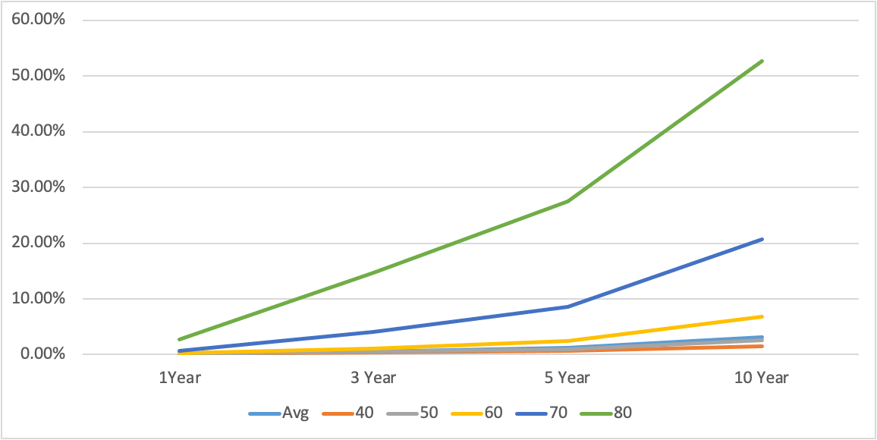
Markov Model - Average model [High to Death][Female]
HBV
HCV
Age Group
Coinfection
Others
HJ. Kwon
Progress Report
NCC-GCSP

Slide 8
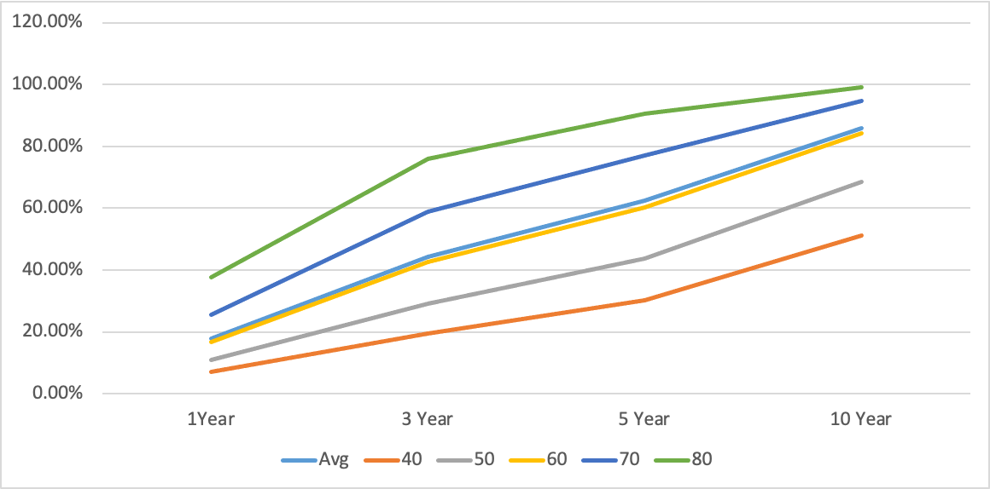
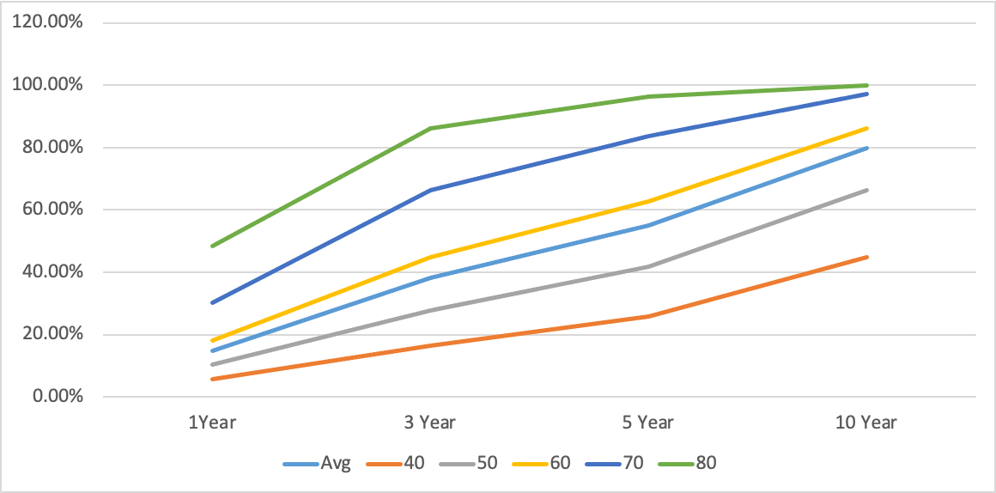
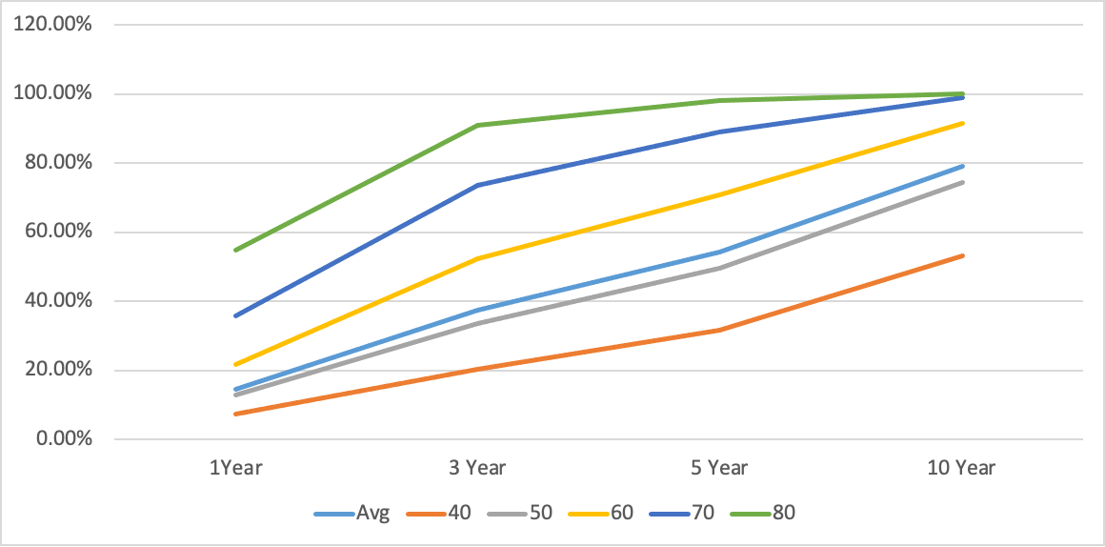
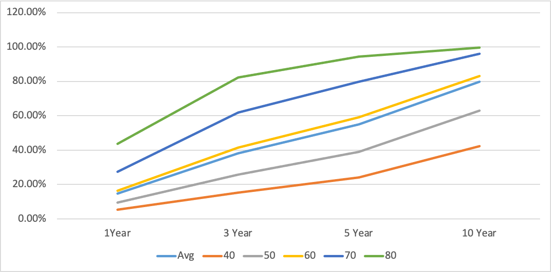
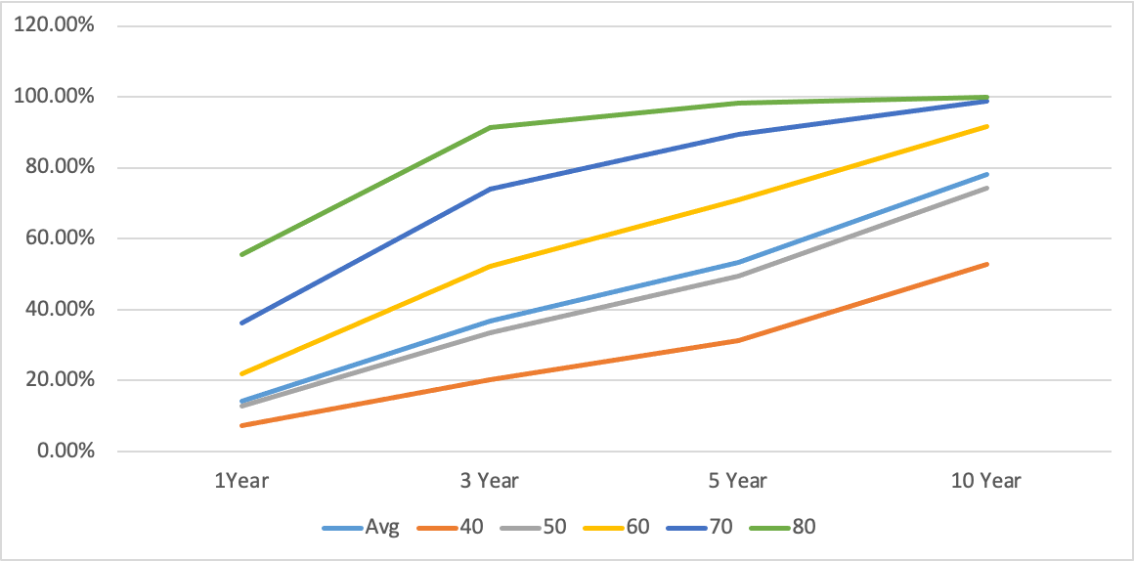
Markov Model - Average model [LVC to Death][Female]
HBV
HCV
Age Group
Coinfection
Others
HJ. Kwon
Progress Report
NCC-GCSP

